Slide 1
Power System Dynamics and Stability
Chapter 10
Synchronized Phasor Measurement
© 2017 Peter W. Sauer, M. A. Pai, and Joe H. Chow, All Rights Reserved

Slide 2
Outline
Background
Phasor calculation
Phasor data communication
Power system frequency response
Power system disturbance propagation
Power system disturbance signatures
Phasor state estimation
Modal analysis of oscillations
Energy function analysis
Control design using PMU data
In late 1980’s, power industry switched from analog relaying to digital relaying, as digital relaying would provide more functionalities and eventually would be cheaper to build.
With the launch of the GPS satellites (1973, originally 24 satellites), it is possible to receive a timing signal every second (accurate to within 2 microseconds) so that the measured voltage and current signals can be time tagged and collected from a wide region.

Slide 3
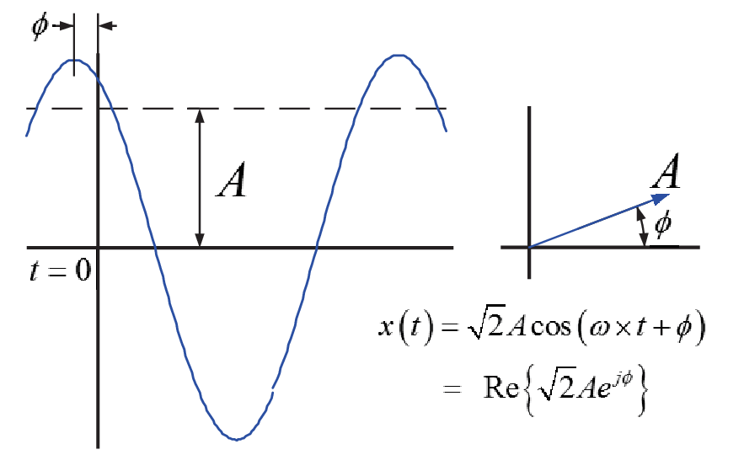
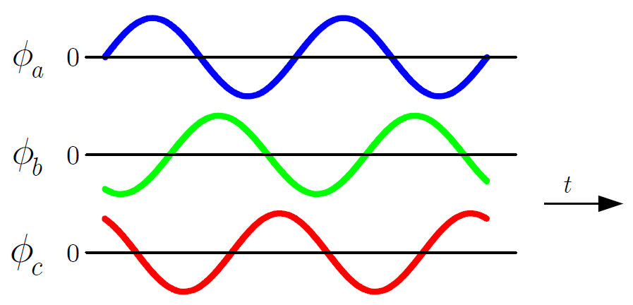
Introduction
US power system: 3-phase sinusoidal AC voltages and currents at a frequency of 60 Hz
Phase a quantities (voltages and currents) lead phase b quantities by 120 degrees, which leads phase c by 120 degrees
A sinusoidal signal can be represented by a cosine function with a magnitude A, frequency ω, and phase φ.
A is the rms value of the voltage/current signal

Slide 4
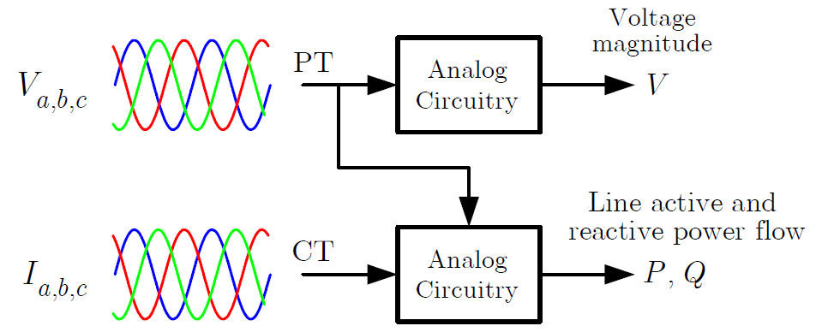
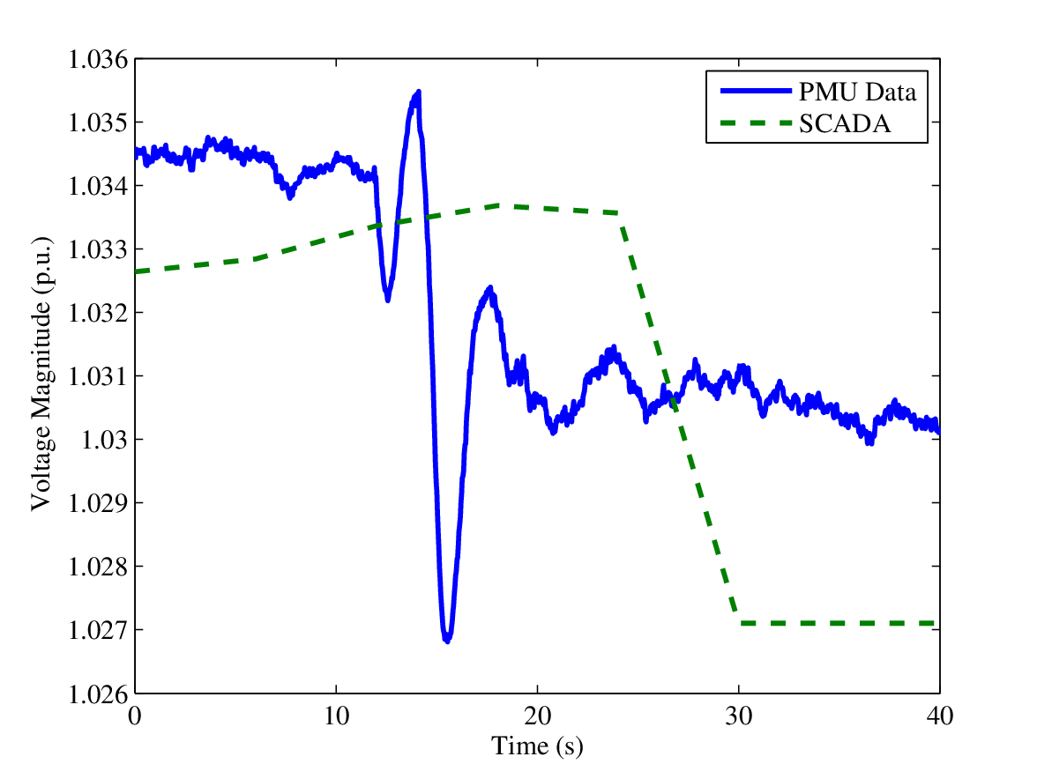
SCADA vs PMU Measurements
SCADA voltage and power measurements
V and P,Q are sampled every 5 sec. An RTU will transmit the data via modems, microwave, or internet in ICCP directly to control rooms or NERC Net.
Data from different locations are not captured at precisely the same time. However, V, P, and Q normally do not change abruptly, unless there is a large disturbance nearby. These data can be used in the State Estimator to validate the measured data and calculate the non-metered voltages and line power flows.

Slide 5
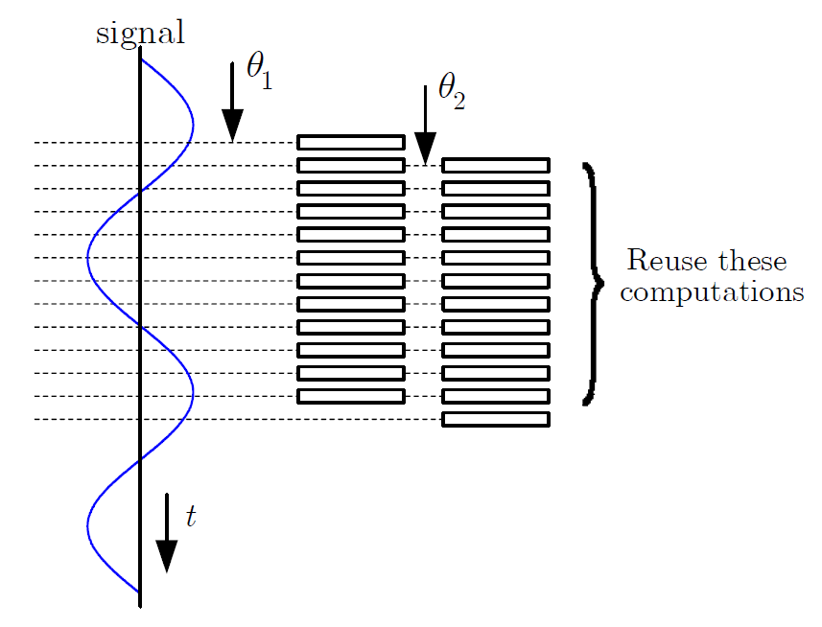
Nominal Frequency Phasor Computation
Signal
Phasor representation (freq is implied)
Apply discrete (fast) Fourier transform
Phasor is computed as
Non-recursive and recursive methods
The recursive method is subject to accumulation of quantization error

Slide 6
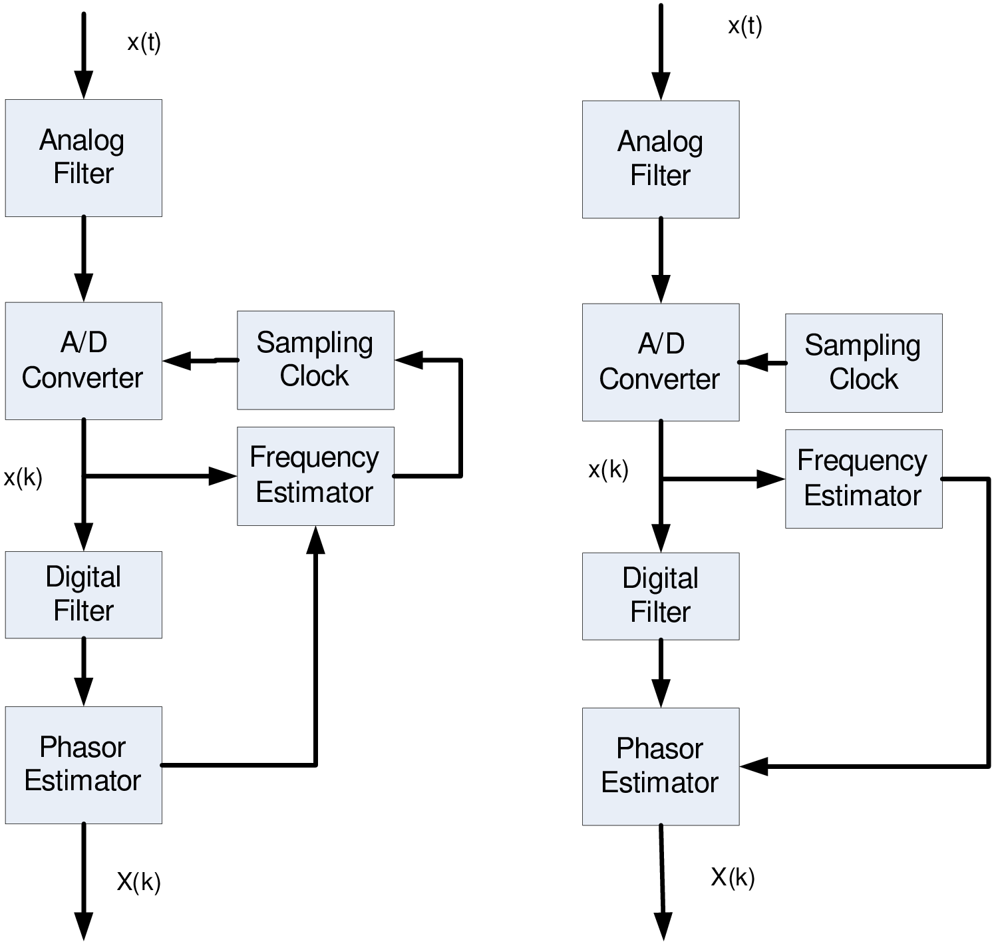
Off-Nominal Frequency Phasor Computation
Even though power systems operate within a narrow frequency band about the nominal frequency, system frequency is rarely at precisely the nominal frequency
Two approaches for off-nominal frequency phasor computation
  Frequency tracking is more computationally intensive as it involves resampling
  Frequency compensation requires computation of correction factors
Frequency tracking Frequency compensation

Slide 7

Frequency Compensation Method
Compute DFT (or FFT) of a sinusoidal signal as if the signal is at nominal frequency
The resulting phasor quantity is
with the correction factors
Note: $\tilde{X}$ is the actual phasor and $∆ω$ is the frequency deviation from nominal value. The second term in ${\tilde{X}}_{r}^{′}$ is a second-harmonic component

Slide 8
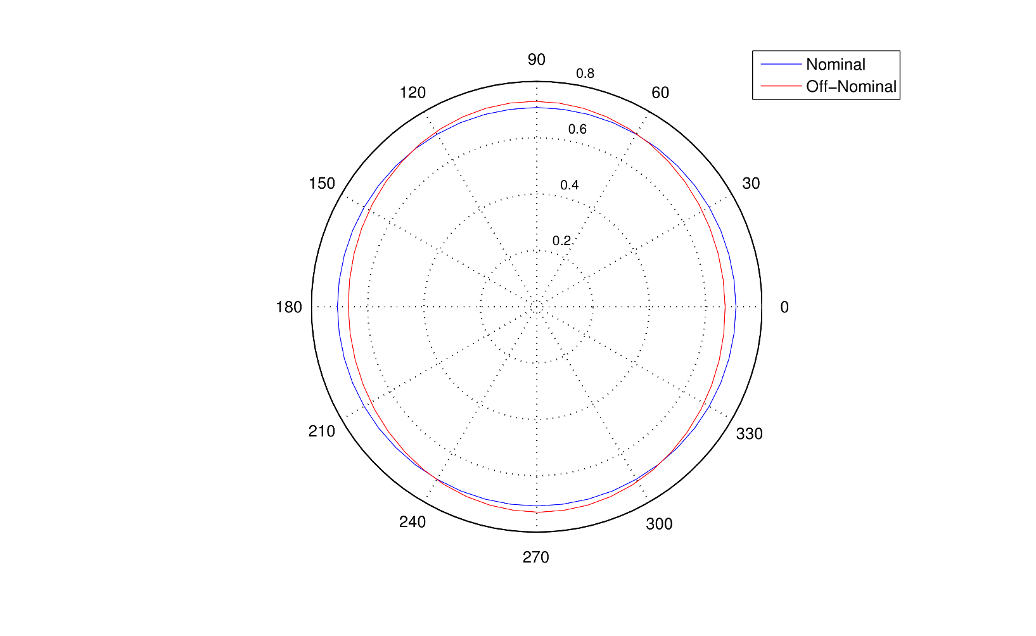
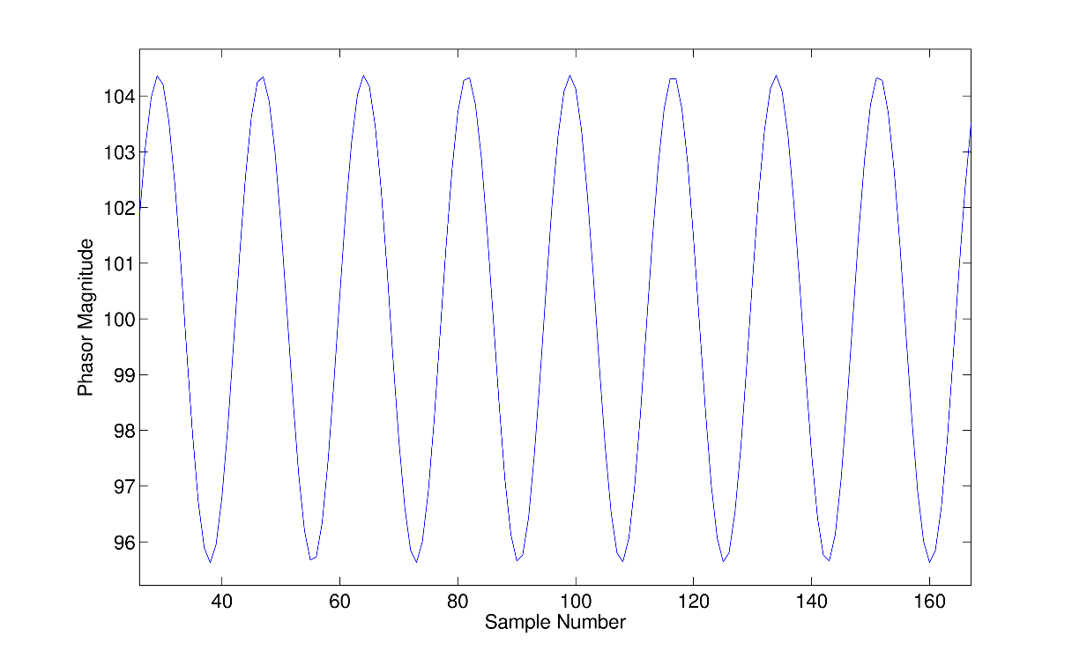
Example: 55 Hz signal (in 60 Hz system)
Signal
sampled at 1.44 KHz.
Second-harmonic component
(b)
(a)

Slide 9
Post Processing of Off-Nominal Frequency Phasors
The objective is to get rid of the second-harmonic component
A simple way is to use a 3-point filter, which can be implemented as
where the magnitude is averaged as
Then the phasor is approximated by
Note that the points selected in the 3-point filter are spaced 120 degrees apart to achieve cancellation of the second-harmonic component

Slide 10
Zero-(0), Positive-(1), and Negative(2)-sequence Phasors
The phasor algorithm can be used to compute the phasors for each phase: a, b, c. Then the sequence quantities are
where
The sequence phasors from the measured data would be
For balanced 3-phase operation, the second-harmonic components in the positive-sequence will cancel, resulting in
Also the negative sequence consists of mostly second-harmonic components

Slide 11
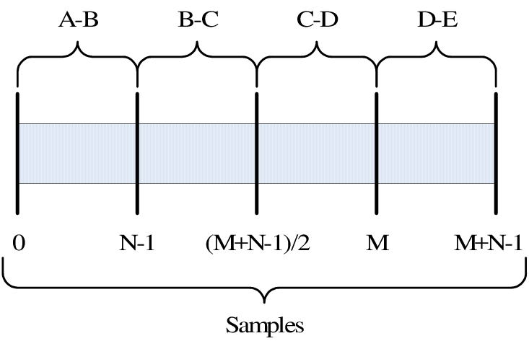
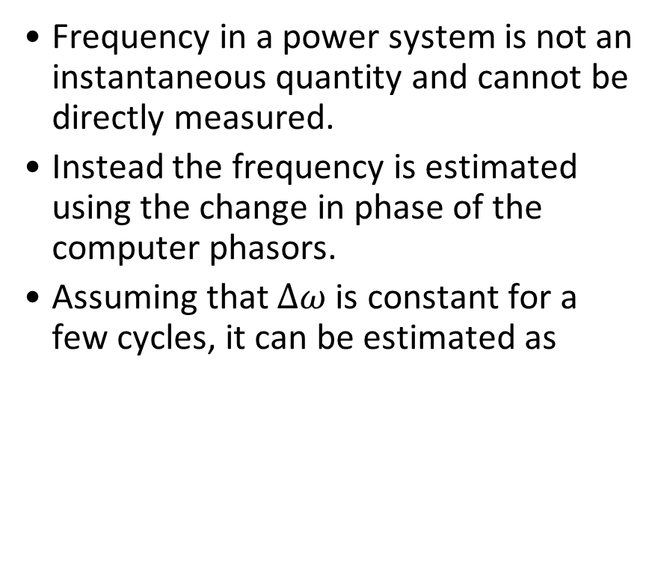
Frequency Estimation
Frequency in a power system is not an instantaneous quantity and cannot be directly measured.
Instead the frequency is estimated using the change in phase of the computer phasors.
Assuming that $∆ω$ is constant for a few cycles, it can be estimated as

Slide 12
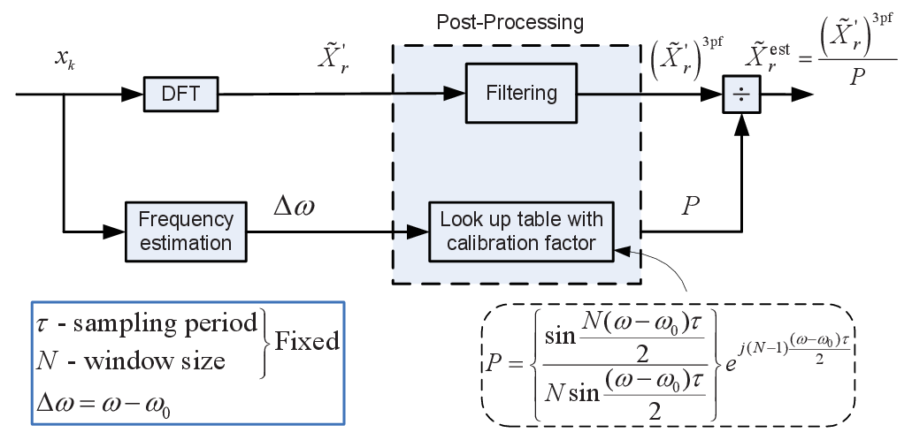
Summary of Phasor Computation

Slide 13
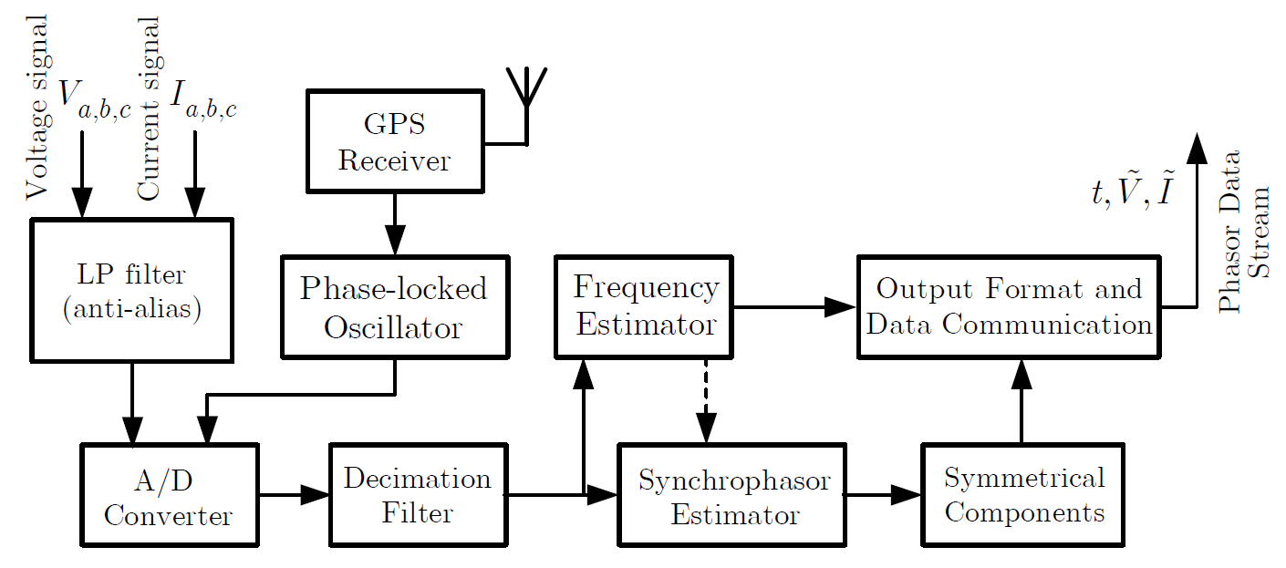
Anatomy of a PMU
Adapted from Arun Phadke and Ken Martin

Slide 14
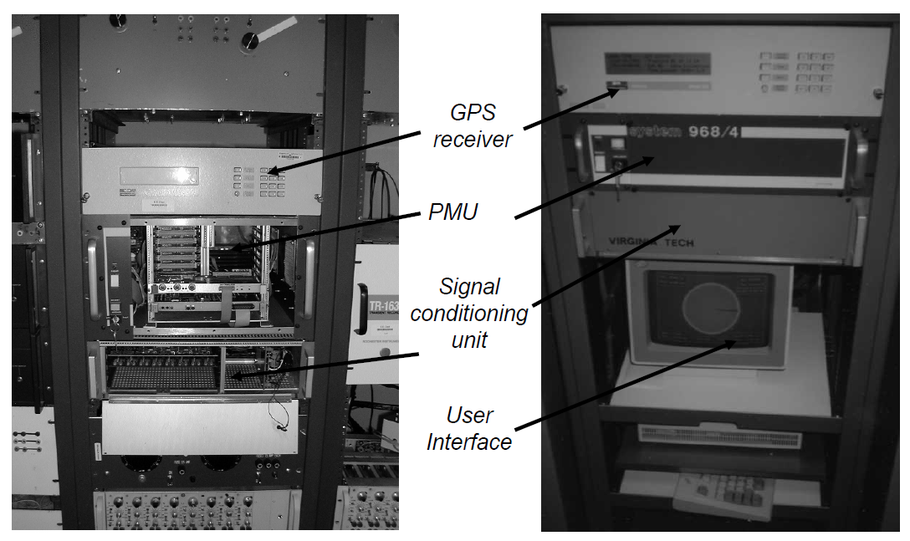
Virginia Tech PMUs
Emergence of computer relaying: digital relays
Development of the first PMUs at Virginia Tech 1982-1992 by Professor Arun Phadke and installed on BPA, AEP, and NYPA systems.
First commercially available PMUs made by Macrodyne (Model 1690, 16/32 channels) in the early 1990s, and installed at US Western System, AEP, and NYPA.
From Arun Phadke

Slide 15
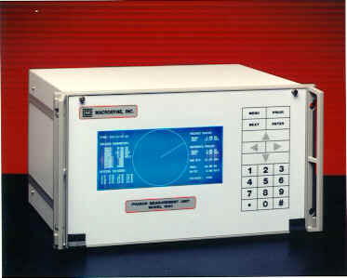
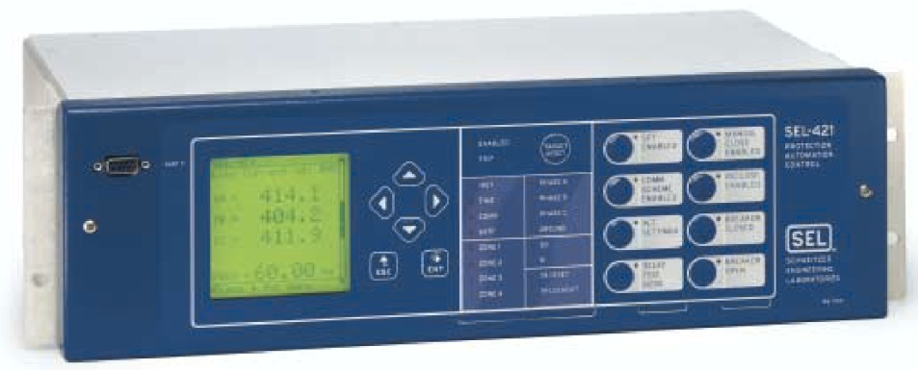


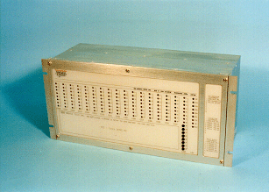
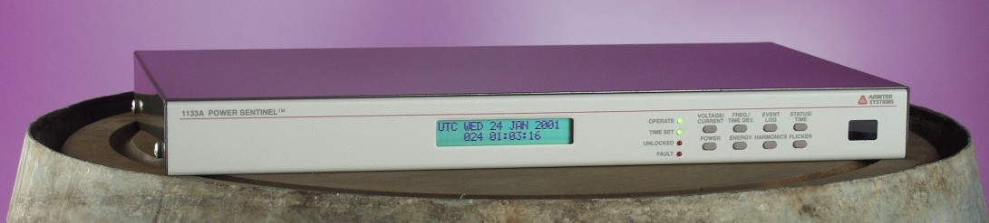
Phasor Measurement Equipment
Schweitzer Engineering Laboratories SEL-421 Protection, Automation, and Control System
GE N60 Network Stability and Synchrophasor Measurement System
Macrodyne Model 1690
Phasor Measurement Unit
Arbiter Power Sentinel 1133A
ABB Phasor Measurement Unit RES 521
Mehta Tech TRANSCAN
2000 IED

Slide 16
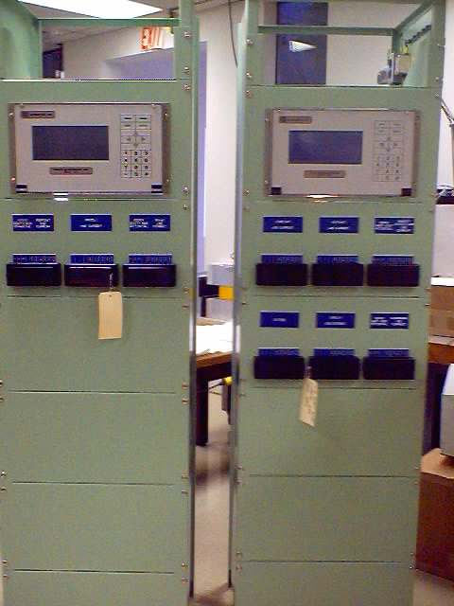
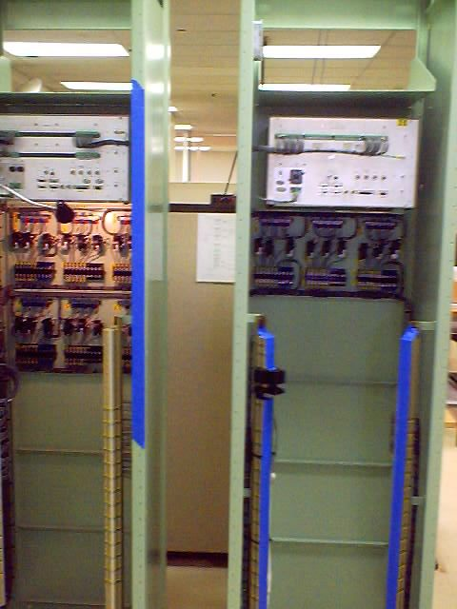
Typical PMU Rack Installation
Front
Rear

Slide 17

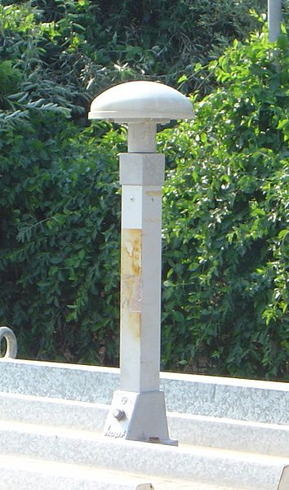
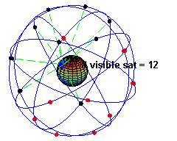
Time Synchronization
GOES (Geostationary Operational Environmental Satellite (NASA)): 25-100 micro-second accuracy
GPS (Global Positioning System, 1973, originally 24 satellites) – 32 satellites in medium Earth orbit: 2 micro-second accuracy
IRIG-B pulses
IEEE 1588: distributed by Ethernet
GPS Antenna
GPS satellites (source: Wikipedia)

Slide 18
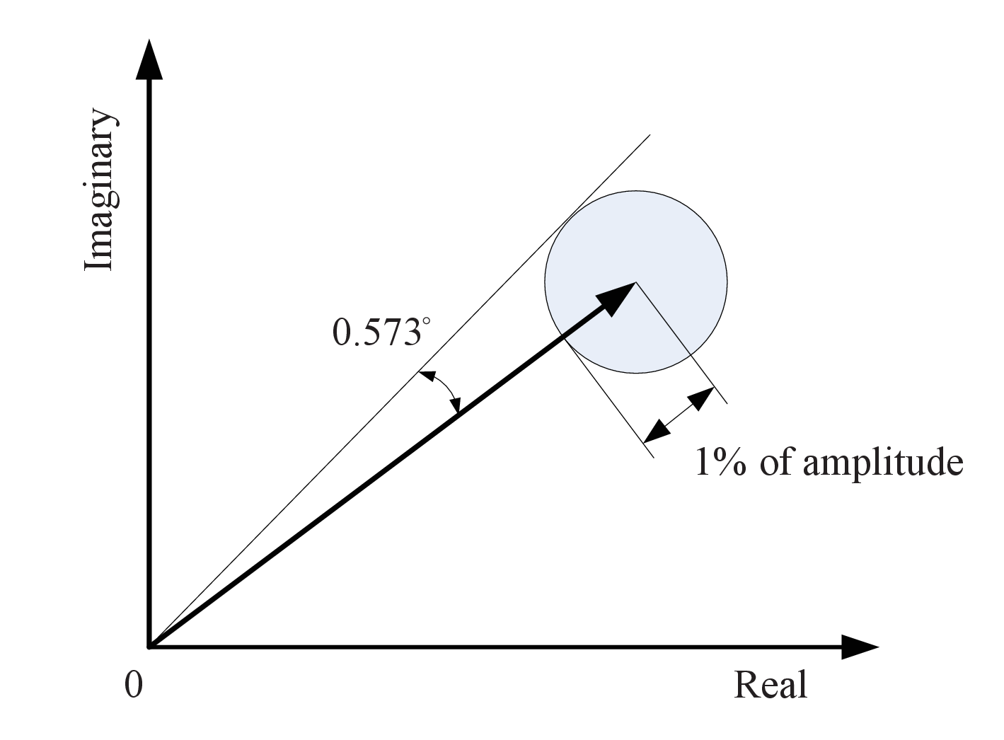
Phasor Data Accuracy
Phasor is a complex quantity
The total vector error accounts for both the magnitude and phase errors
where and are the real and imaginary parts of the estimated phasor
The shaded region is 1% error, as required by the latest IEEE C37.118 standard

Slide 19
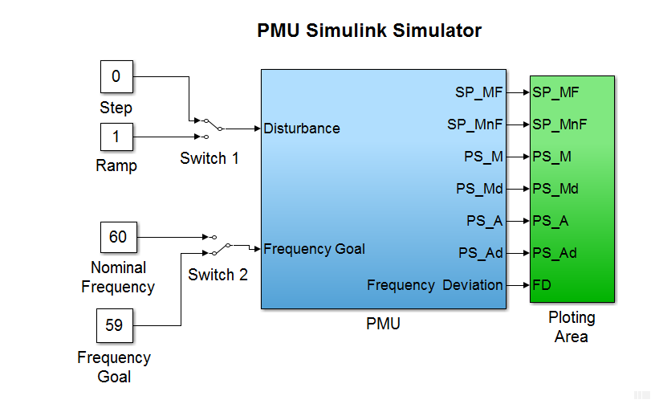
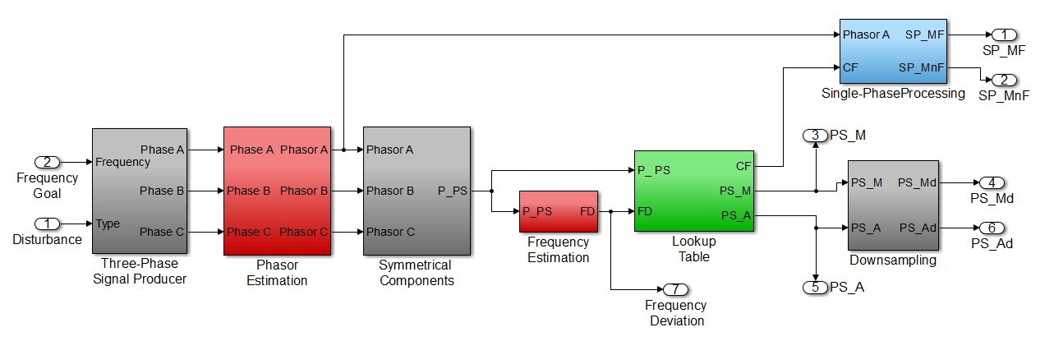
MATLAB PMU Simulator
Capabilities
Off-nominal frequency phasor
Unbalanced phase operation
Impact of correction factors
Process real measured raw PMU data

Slide 20
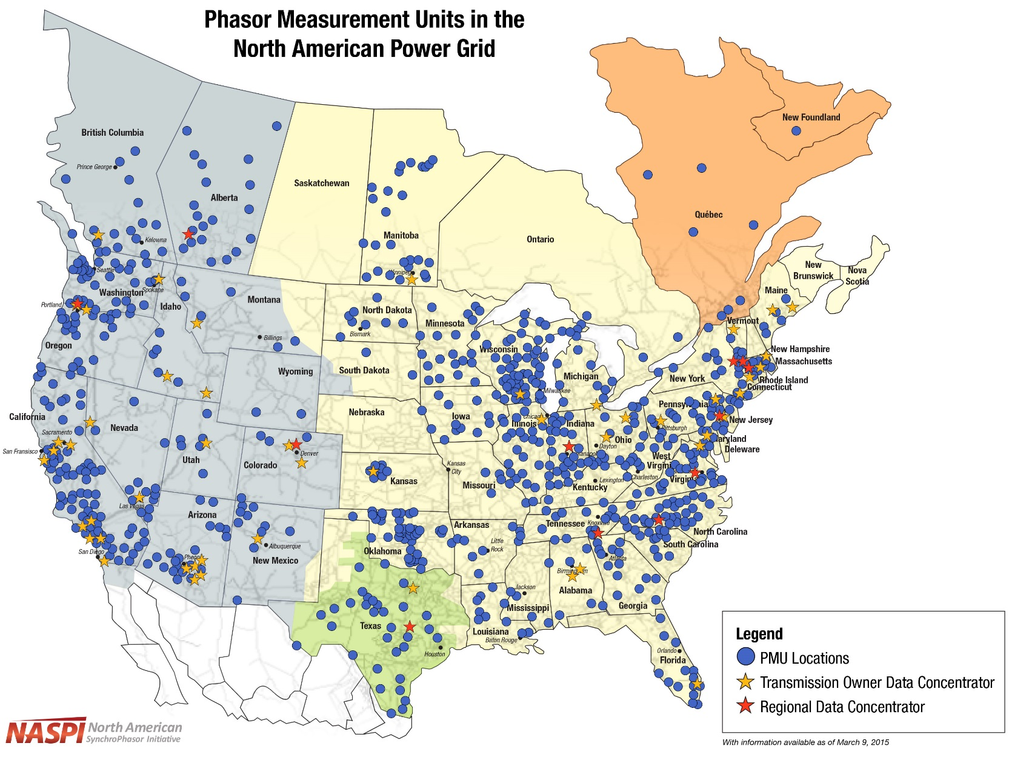
North America PMU Installations
Over 2500 PMUs installed as of June 2017
Many PMUs were installed as part of the US DOE Smart Grid Investment Grant (SGIG) program

Slide 21
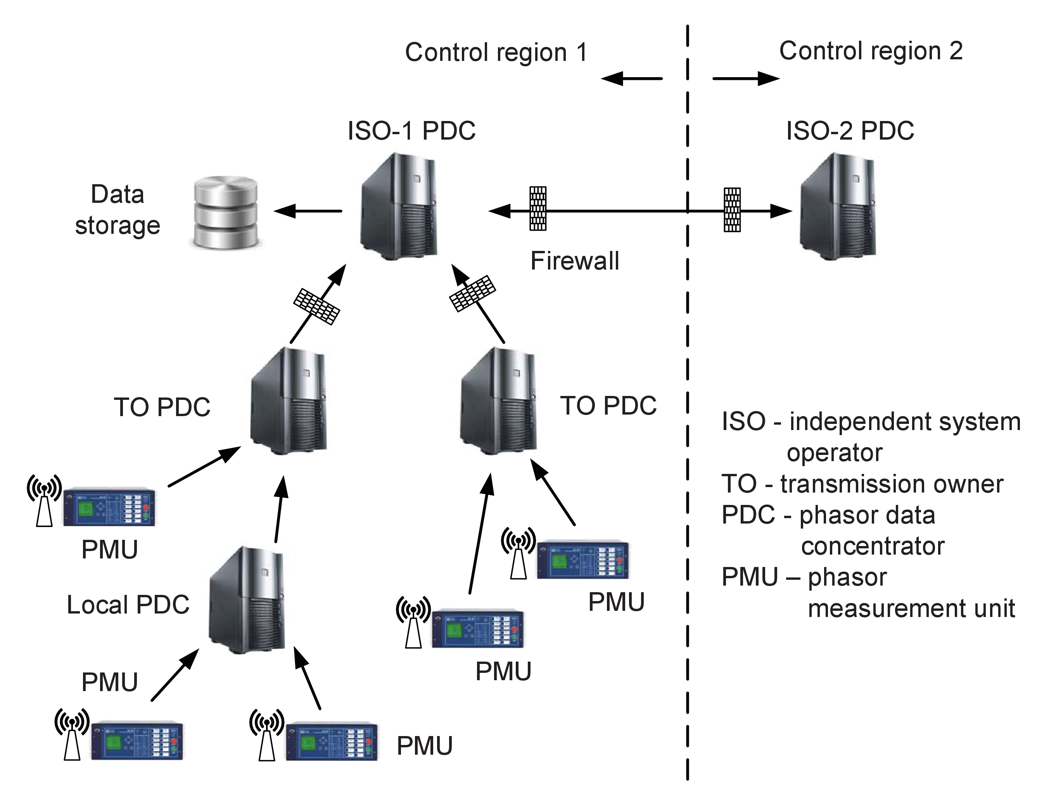
Phasor Data Communication
PMU data is collected at a substation and streamed to a phasor data concentrator (PDC) at the transmission owner (TO)
The concentrated phasor data is further streamed to a PDC at the independent system operator (ISO)
Phasor data may also be shared between ISOs
Data communications allow a wide-area view of power system dynamics and for feedback control using remote PMU signals

Slide 22
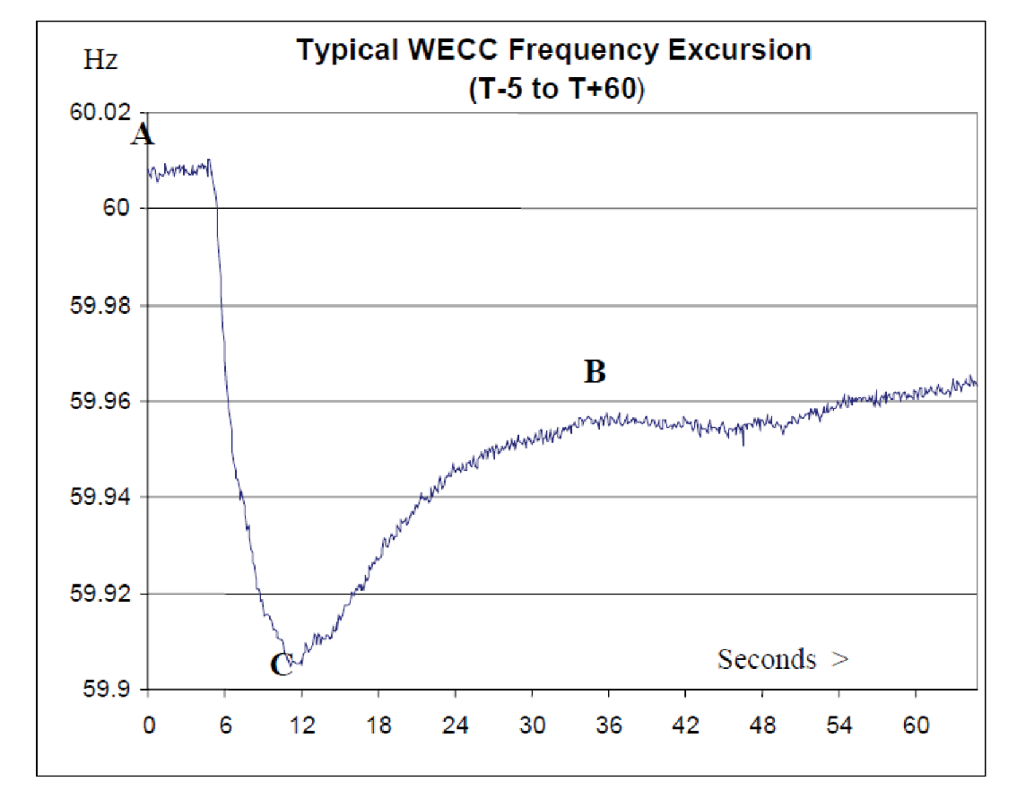

Power System Frequency Response
The trip of a large generating unit in a power system would cause the system frequency to drop
Atypical system frequency response for the US Western System for loss of a unit is shown on the right
From the governor response capability, the post-fault steady-state frequency is
where is known as the frequency response with a unit of MW/0.1 Hz (D is the frequency sensitivity of the aggregate load, and R is the aggregate droop of the governors)
A: Pre-fault steady-state frequency
B: Post-fault steady-state frequency
C: Nadir

Slide 23
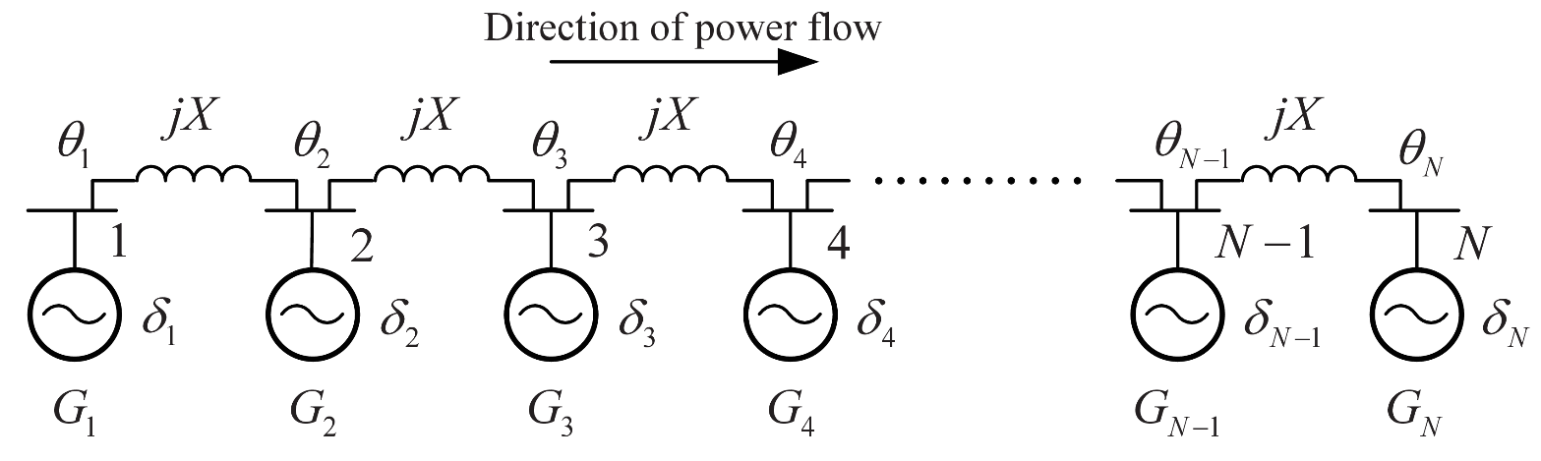
Power System Disturbance Propagation
For a large power system, the disturbance at one end of the system may take a few seconds to reach the other end of the system
This phenomenon can be modeled by
a partial differential equation for the electromechanical model of a radial power system
Trip of Gen 1 in Fig. 10.11 will cause a frequency wave to go from left to right
Assuming uniformly distributed inertia and reactance, define
as per-unit length quantities
The classical electromechanical equation can be modeled as a wave equation
Propagation speed is

Slide 24
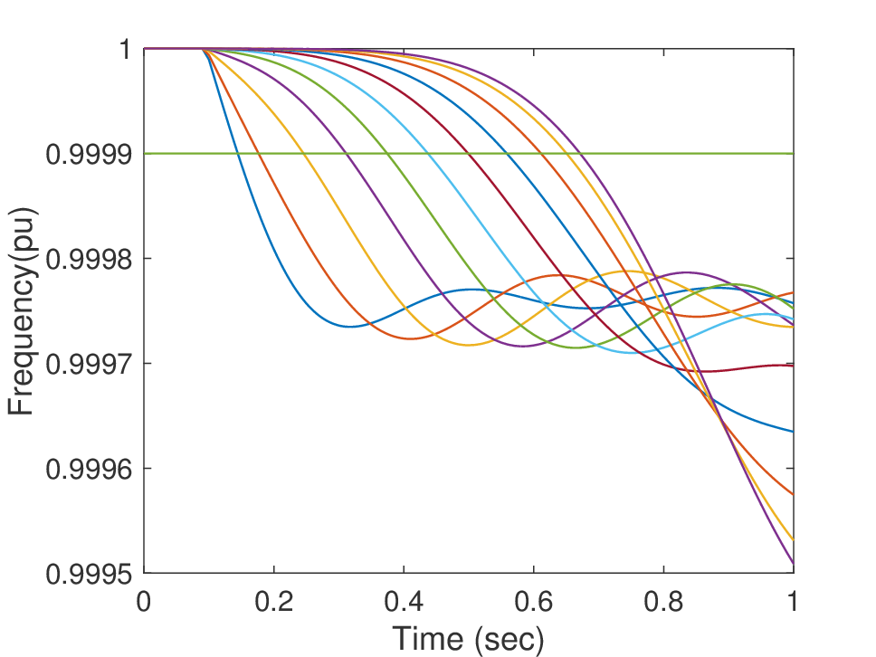
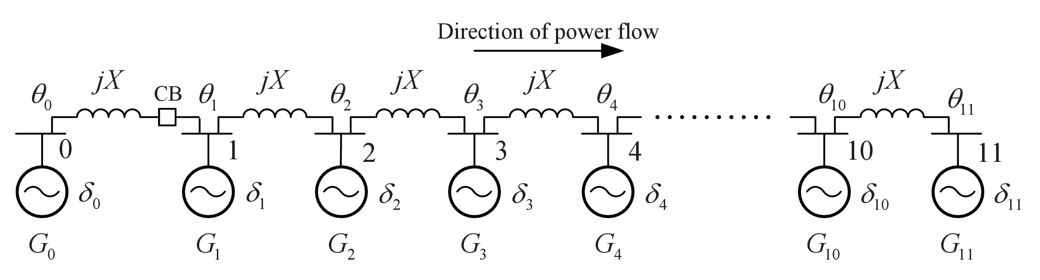

Power System Disturbance Propagation
The general solution to a wave equation
consists of a forward (incident) wave and a reflected wave, both travelling at a speed of c
Example: 11 generators, X = 0.1 pu, H = 3.0 pu, D = 1 pu, $X_{d}^{′}$ = 0.245 pu
Trip Gen 0 (5 MW)
Generator 11
Generator 1
Wave eqn:
1/c = 0.564 sec
Simulation: travel time is 0.53 sec

Slide 25
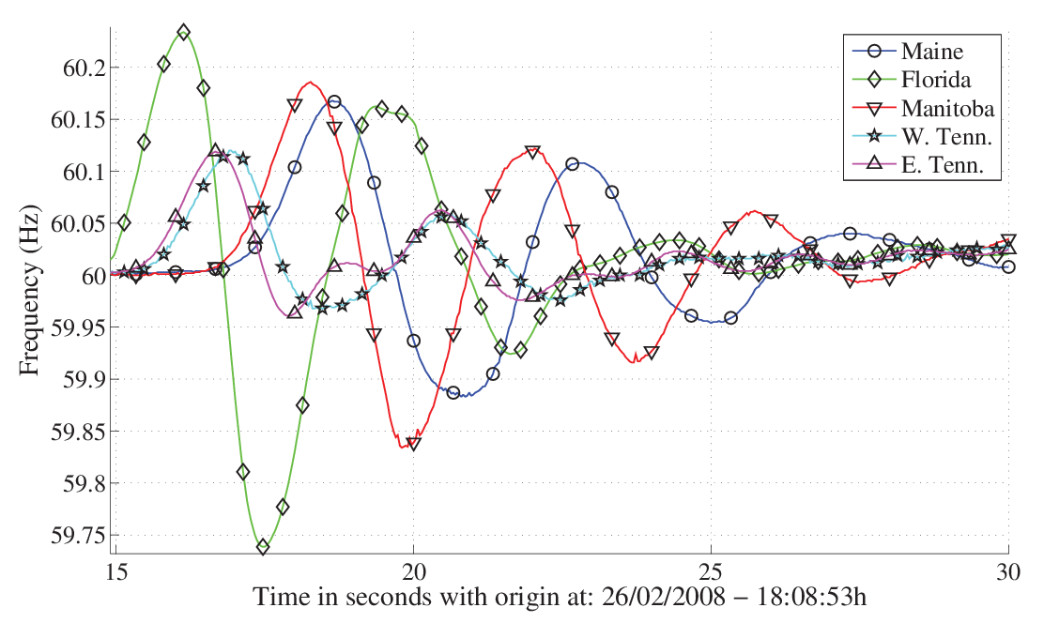
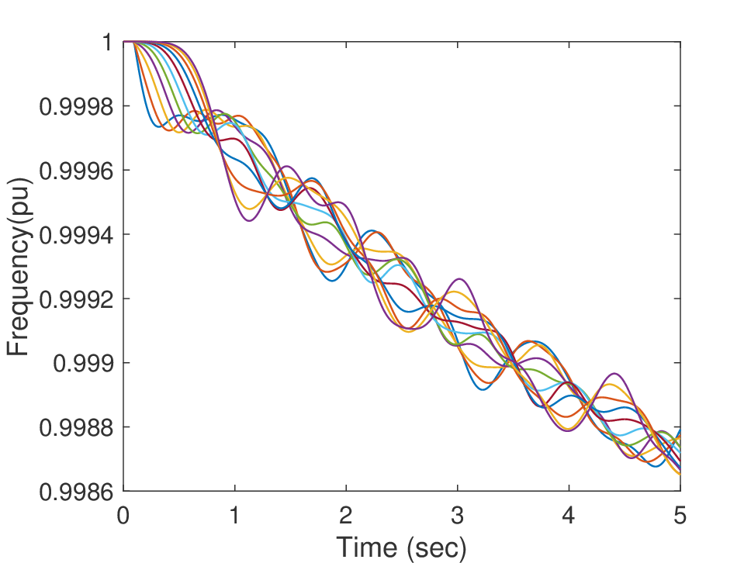
Power System Disturbance Propagation
Longer time simulation shows both incident and reflected waves
Mixing of the incident and reflected waves allows the oscillations to be “synchronized”
Florida generation-load trip event showing disturbance propagation from Florida to Manitoba and Maine in a meshed network

Slide 26
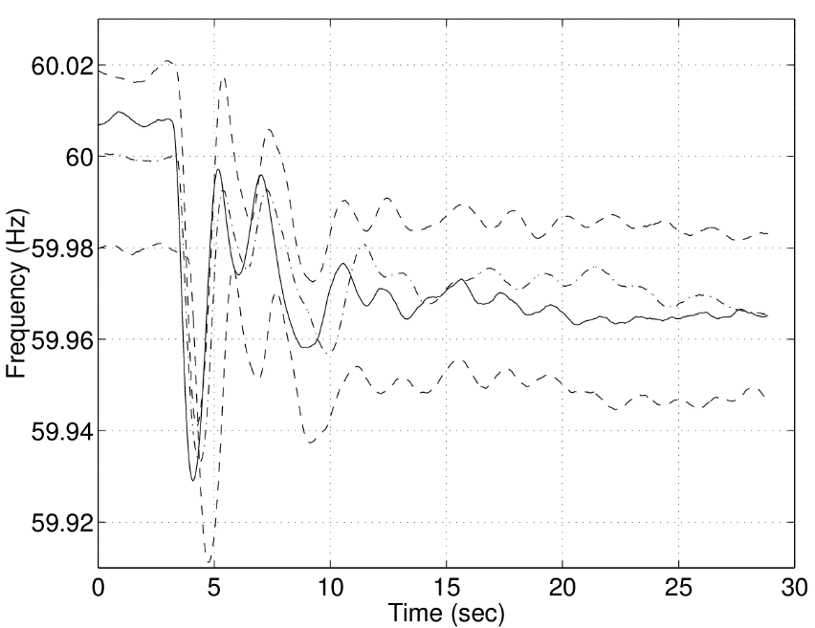
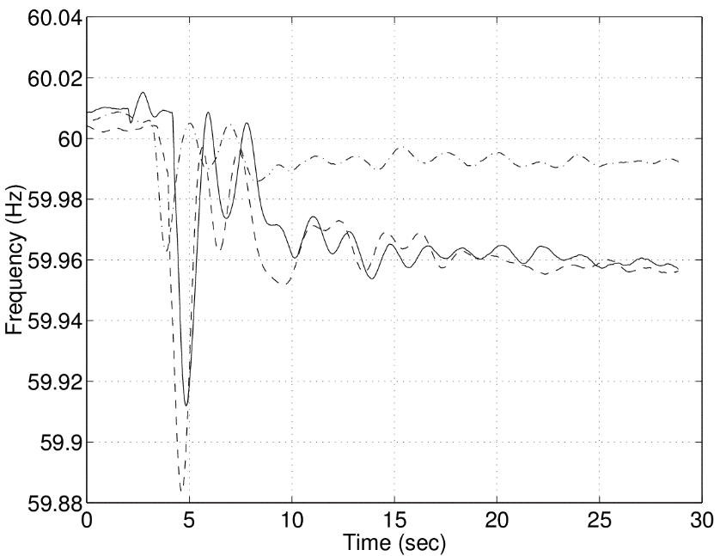
Power System Disturbance Signatures
Loss of generation
Loss of loads (remote pumped hydro unit)
Several Millstone
trip events
Several HVDC 1-Pole trip events

Slide 27
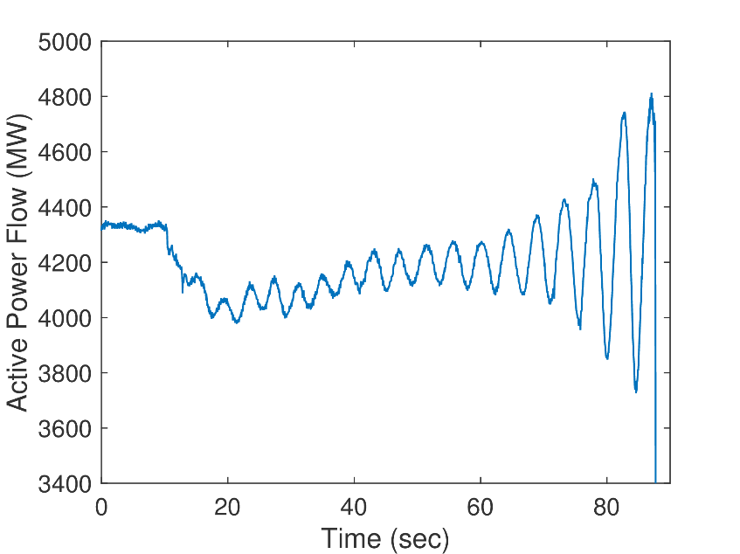
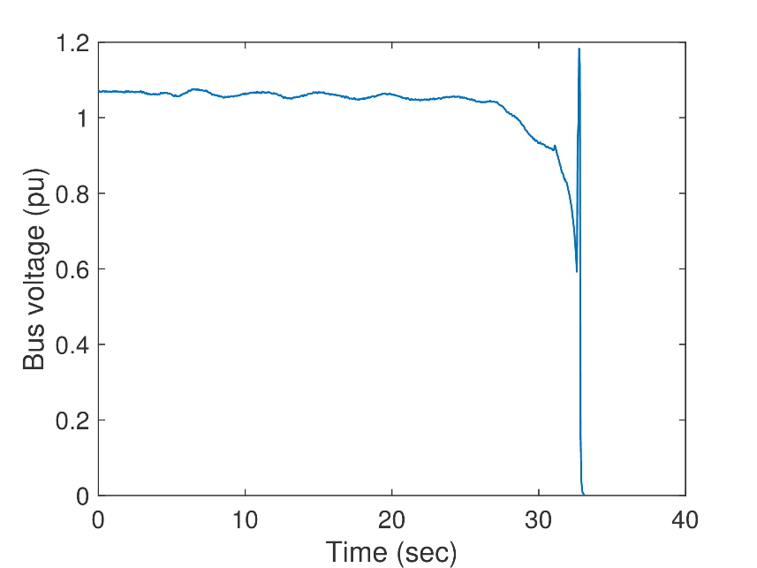
Power System Disturbance Signatures
Oscillations
Line trip and
successful
reclosing
Shunt
switching
event
Voltage
collapse

Slide 28
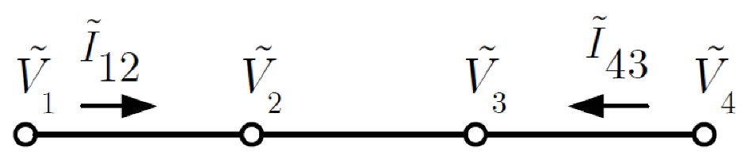
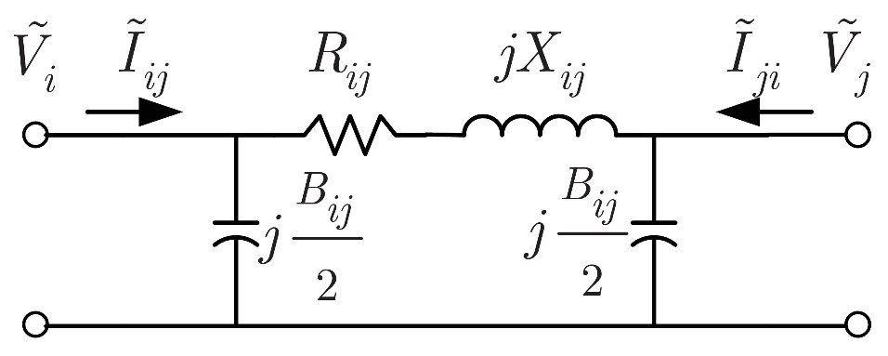
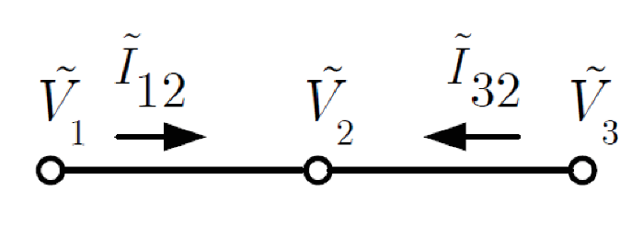
Phasor State Estimation
Circuit equation for the transmission line
In Fig. 10.24, the voltage phasors at Buses 2 and 3 and hence the current on the line between these buses can be computed. Note that this is not possible with SCADA state estimators, because the phase difference between these two buses is not measured.
In Fig. 10.25, the voltage phasor at Bus 2 can be computed from either Bus 1 or Bus 2, allowing for least-squares approximation.

Slide 29
Mechanics of Linear State Estimation
Consider the 3-bus configuration in Fig. 10.25.
Write the 10 unknown voltage and current phasors in rectangular form as
Current flow equations in rectangular coordinates are
12 equations for 10 unknowns: 4 V and 4 I measurements + 4 I flow eqns.
Set up linear equation Ax = b with b

Slide 30
Mechanics of Linear State Estimation
The A matrix is given by
More equations than unknown, so solve as a weighted least-squares problem

Slide 31
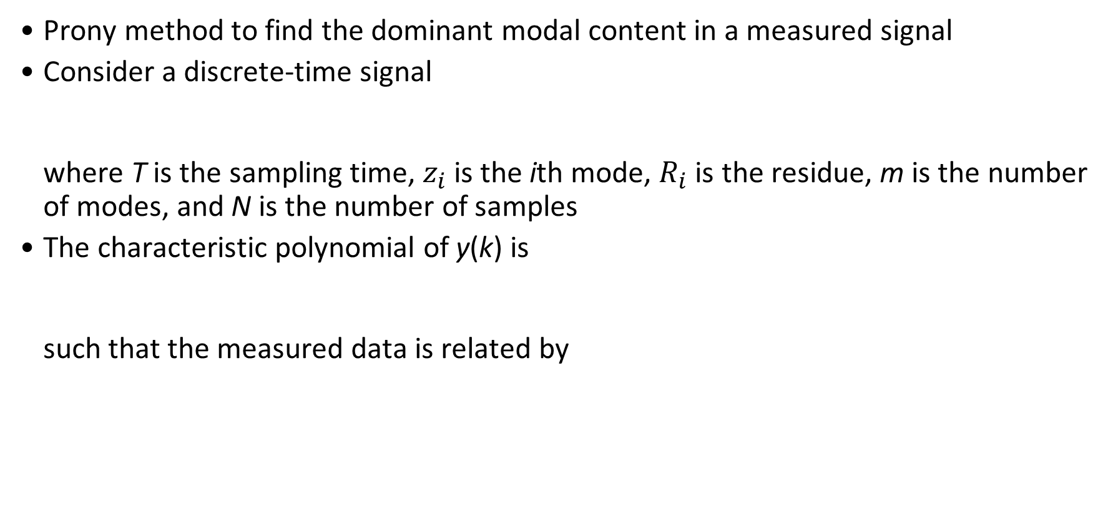
Modal Analyses of Oscillations
Prony method to find the dominant modal content in a measured signal
Consider a discrete-time signal
where T is the sampling time, $z_{i}$ is the ith mode, $R_{i}$ is the residue, m is the number of modes, and N is the number of samples
The characteristic polynomial of y(k) is
such that the measured data is related by

Slide 32
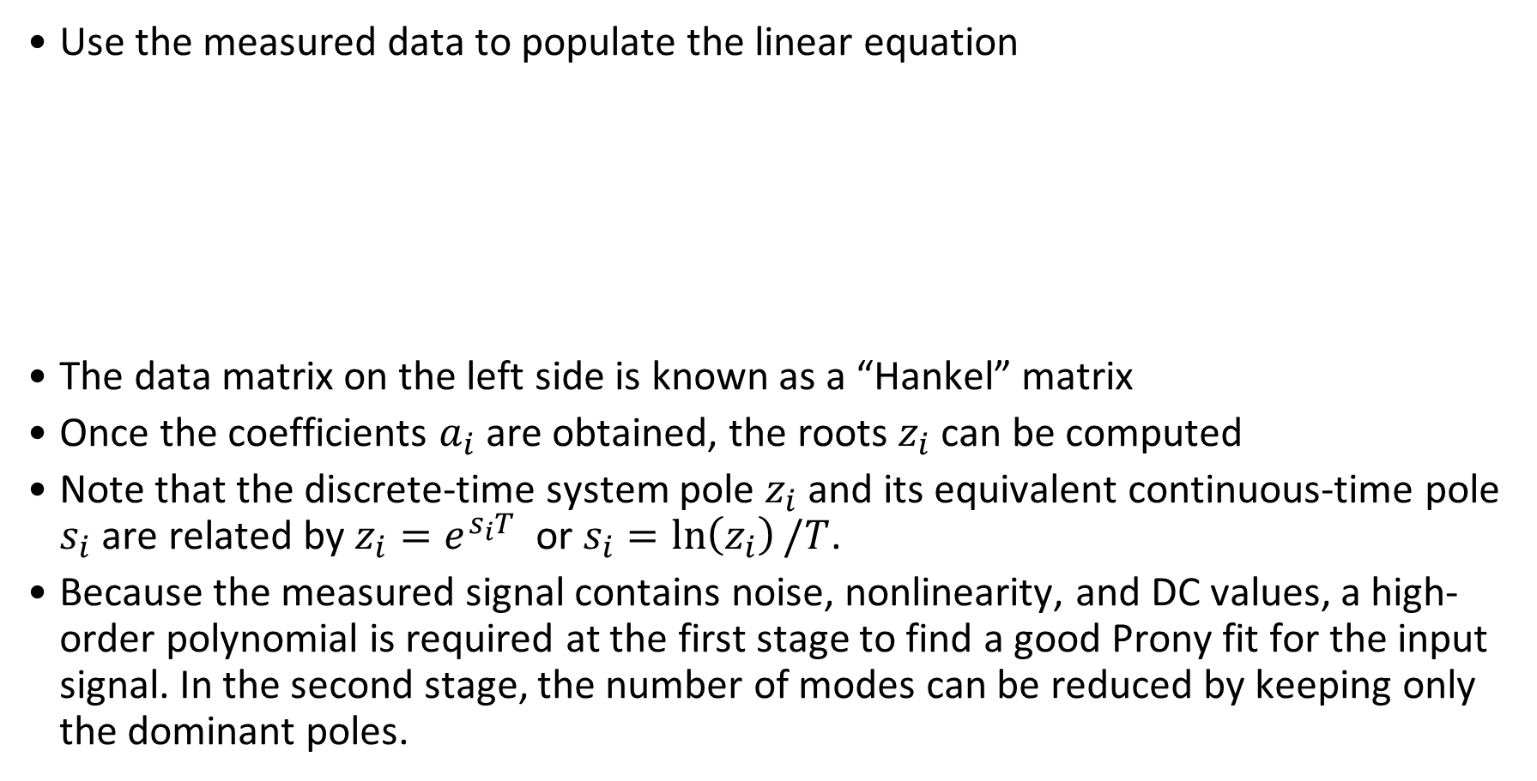
Modal Analyses of Oscillations
Use the measured data to populate the linear equation
The data matrix on the left side is known as a “Hankel” matrix
Once the coefficients $a_{i}$ are obtained, the roots $z_{i}$ can be computed
Note that the discrete-time system pole $z_{i}$ and its equivalent continuous-time pole $s_{i}$ are related by $z_{i}=e^{s_{i}T}$ or $s_{i}=\ln\left(z_{i}\right)/T$.
Because the measured signal contains noise, nonlinearity, and DC values, a high-order polynomial is required at the first stage to find a good Prony fit for the input signal. In the second stage, the number of modes can be reduced by keeping only the dominant poles.

Slide 33
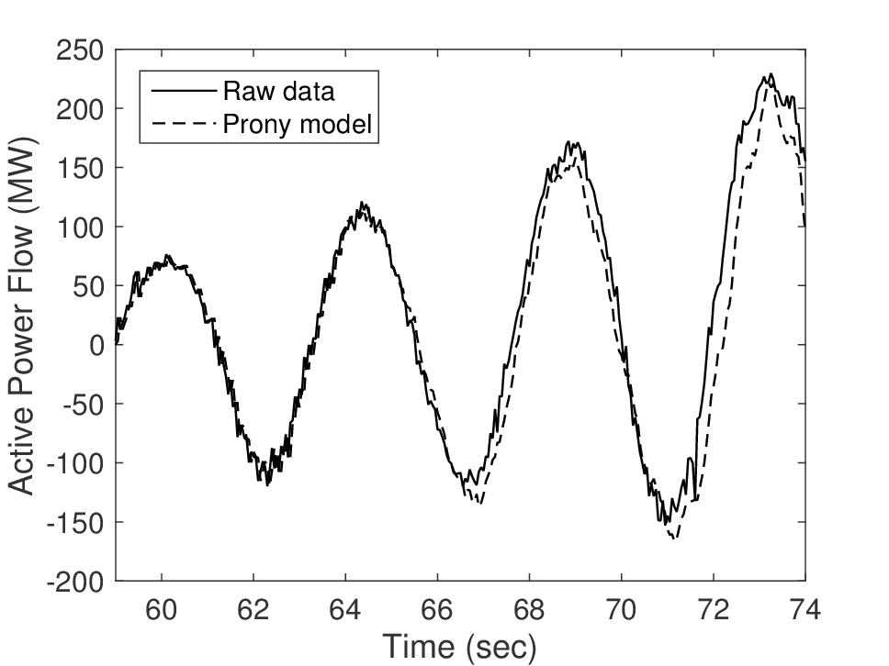
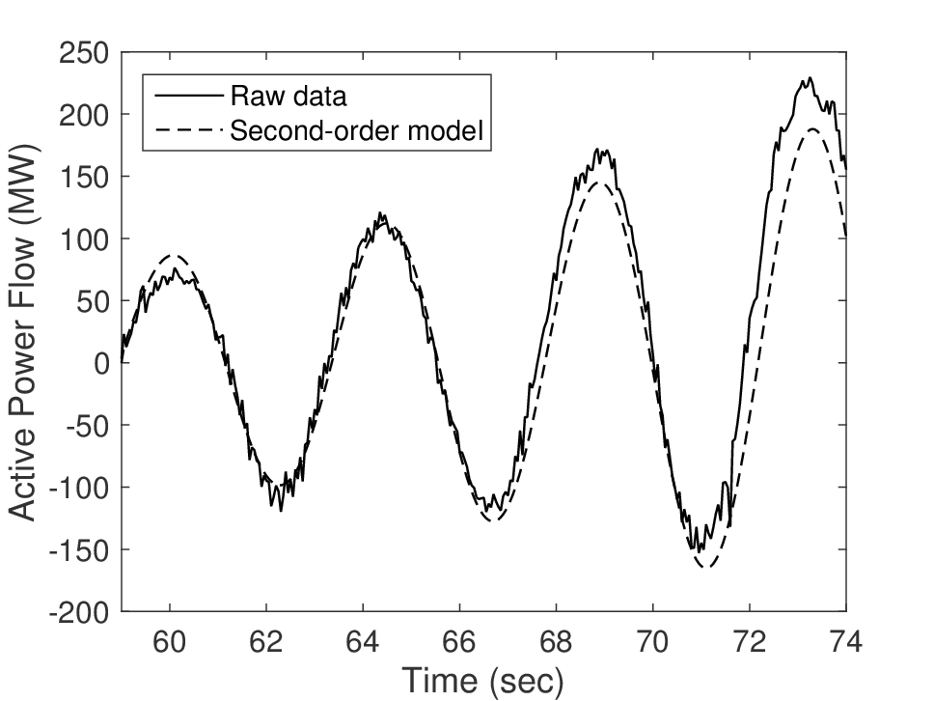
Modal Analysis Example
100th-order fit: note a large DC component removed
2nd-order fit

Slide 34
Energy Function Analysis - Review
This example demonstrates the concept of energy functions using PMU data
From Chapter 9, the total energy function is
where the potential energy is
and the kinetic energy is
The event:
  Some control equipment malfunctioned at a generating plant
  The power system can be modeled as a two-machine system
  The machine inertias and the equivalent reactance between the two machines can be estimated from PMU data using the methods in [179,180]
The measured data will clearly show that the energy function captures the electromechanical oscillations (Note that the energy function is used to determine the transient stability of power systems, which is a function of the machine swing dynamics)

Slide 35
Recorded PMU Data

Slide 36
Energy Function Plots
KE PE Total Energy
Note KE and PE contain oscillations from the machine swings
Total energy does not show machine swings. Without the swings, the external stimuli are clearly visible.

Slide 37
Control Design using PMU Data
Effective damping of swing modes requires good controllability and observability
Using PMU data, one can obtain signals with clear swing mode content, thus improving observability
However, remote PMU data may have to be used, and thus requiring a
communication system to
send the data (see figure
to the right)
The bottom line is that PMU data will have a time delay: data processing and storing, data transmission, … - hopefully < 100 ms
Delay in time is equivalent to phase lag in frequency domain
Thus in damping control design using PSS (Chapter 8), more phase lead will be required in the phase compensator

Slide 38
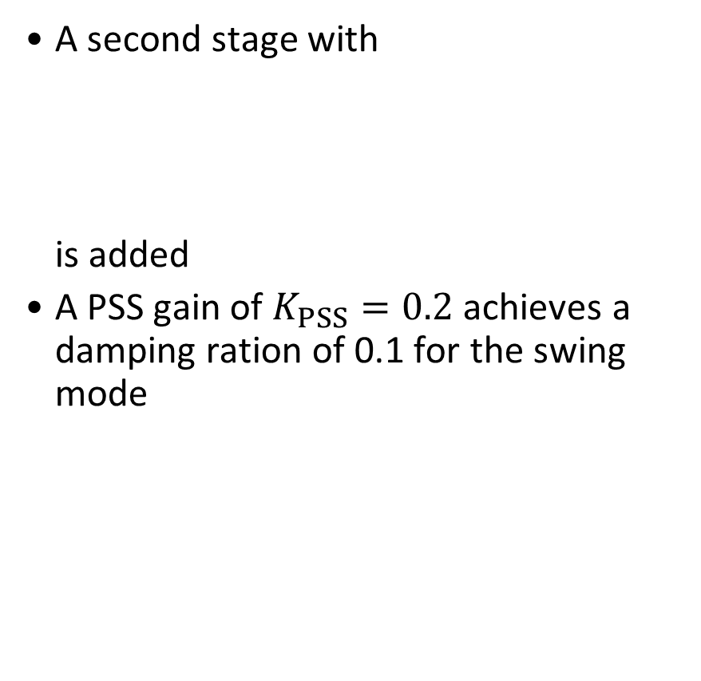
Example: Control Design using PMU Data
Interarea mode at 3 rad/s
Delay = 100 ms implies a phase lag
Use 1st-order Padé approximation
to model the impact of the delay
We will insert the Padé function into the feedback path of the PSS design system in Example 8.7 and redesign the phase compensation
The original compensator has only 1 stage
A second stage with
is added
A PSS gain of $K_{PSS}=0.2$ achieves a damping ration of 0.1 for the swing mode

Slide 39
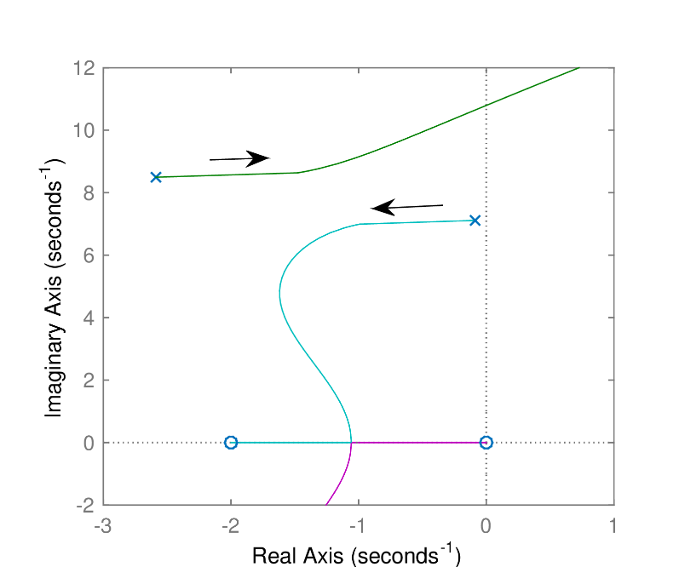
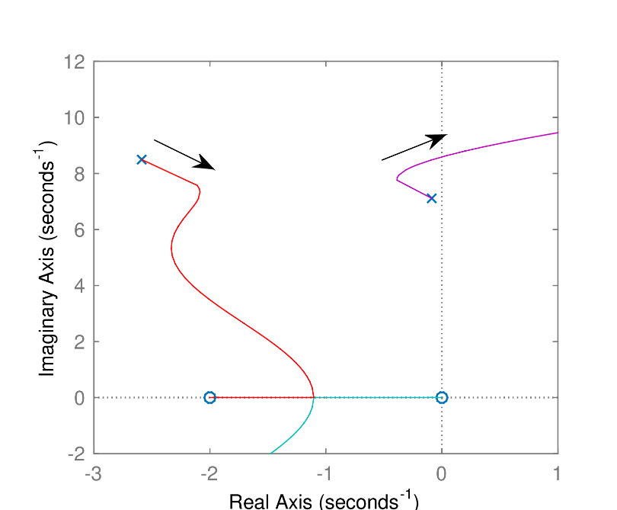
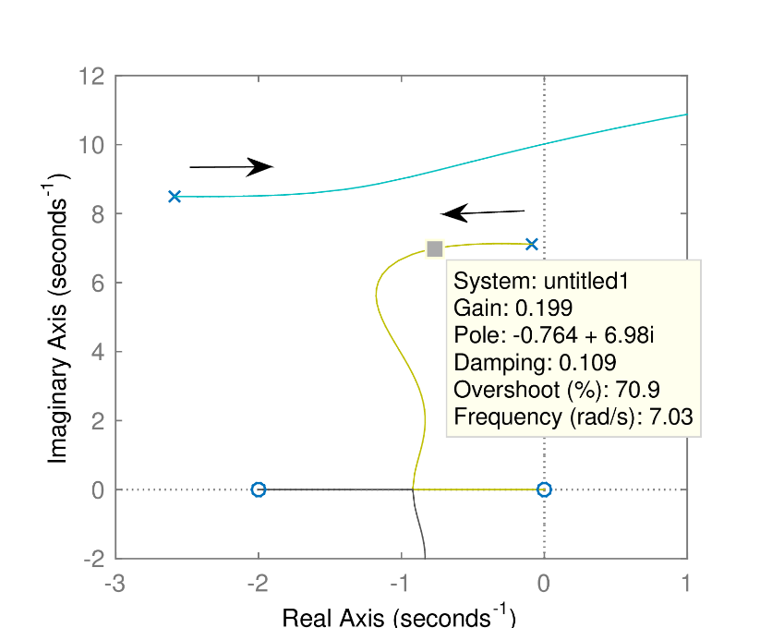
Example: Control Design using PMU Data
Root-locus plot with no time delay
Root-locus plot with time delay but no additional phase comp
Root-locus plot with time delay and additional phase lead comp

